Slide 1

AquaGrade AI:
Advanced Fish Quality Assessment System

Slide 2
The Problem: Why We Built This
Manual fish quality assessment remains fundamentally subjective and inconsistent across the industry. Different inspectors apply varying standards, leading to unpredictable quality determinations.
This subjectivity creates significant challenges for markets, restaurants, and consumers who rely on accurate quality information.
The Real Challenge
Limited availability of real-world training data
Synthetic image generation failed completely (45% accuracy)
Persistent model overfitting issues during development
Hardware limitations extending training time
The impact extends beyond inconsistency. Quality variations directly translate to price fluctuations, where identical fish receive different valuations based on who performs the assessment.
The industry desperately needs an objective, automated quality assessment system that delivers consistent, reliable results regardless of the evaluator.
Complex API integration problems
Spoiler alert: Building this system wasn't easy, but the results were worth the struggle.

Slide 3




System Overview: What We Actually Built
Image Upload
AI Analysis
Users submit fish images through our intuitive interface
Deep learning models process visual features
Quality Assessment
Results Display
System generates objective quality grades
Comprehensive quality reports with market valuation
Our system delivers three core capabilities: accurate species identification across eight common varieties, objective quality grading based on visual indicators, and real-time market valuation estimates. Target users include fish markets seeking consistency, restaurants demanding quality verification, professional quality inspectors, and informed consumers.
Key benefit: Objective, consistent, and fast quality assessment—when it's working properly. The system processes images in approximately 1.2 seconds, delivering results that would take human inspectors several minutes to determine.

Slide 4
Frontend Architecture: React.js
Our component architecture includes ImageUpload for handling user submissions, PredictionDisplay for rendering AI results, DashboardLayout for organizing the interface, and FishDirectory for species information. We refactored these components three times to achieve optimal structure and reusability.
Tech Stack Highlights
React 18.2.0 + TypeScript
Vite build tool
Tailwind CSS
State management relies on React hooks rather than external libraries, keeping the bundle size manageable. Radix UI components saved countless hours of custom CSS work. We implemented bundle size optimization and lazy loading to improve performance, though the bundle remains larger than we'd like.

Slide 5




Database & Backend: Supabase Integration
PostgreSQL Database
Schema Design
Supabase provides our PostgreSQL backend with Row Level Security (RLS) for data protection. Understanding RLS policies took significant time, but the security benefits are substantial.
Three core tables: profiles for user data, fish_predictions for analysis results, and fish_species for reference information. We redesigned the schema twice to optimize query performance.
Authentication
File Storage
Supabase Auth handles email/password authentication. We considered social login but the complexity wasn't justified for our MVP timeframe.
Integrated storage for images and exported reports. Upload size limits proved restrictive for high-resolution images, requiring client-side compression.
Real-time subscriptions enable live updates as predictions complete. The file storage system handles both original images and generated PDF/CSV exports, though we're still optimizing the export pipeline for speed.

Slide 6
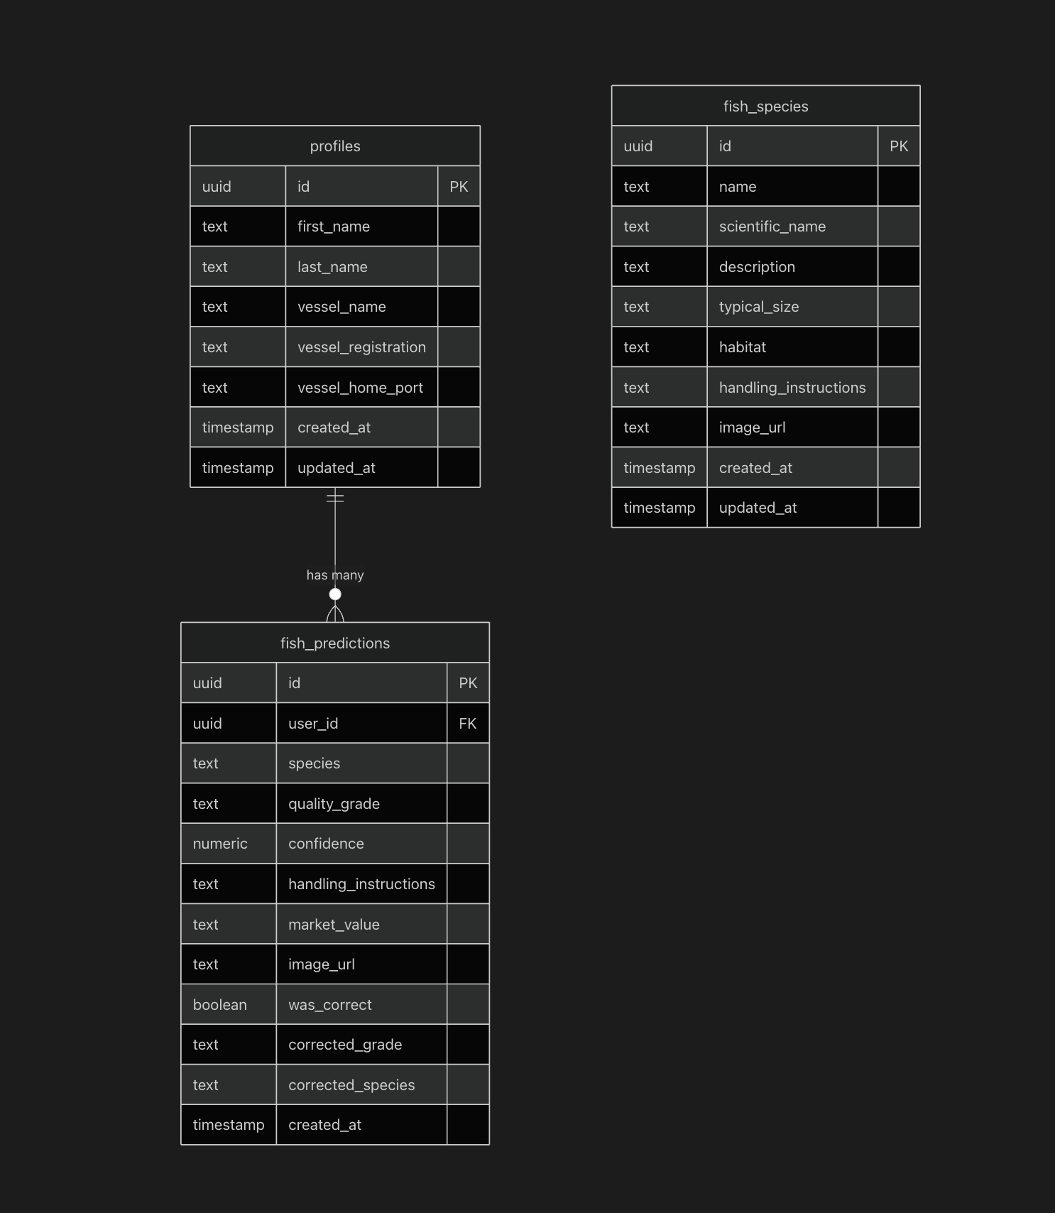
Database & Backend: Supabase Structure
Current Relationships:
profiles ↔ auth.users: One-to-one relationship storing user information (name, vessel details)
fish_predictions → profiles: Many-to-one relationship linking predictions to users via user_id
Tables:
profiles: User account details and vessel information
fish_predictions: Analysis results with species name (text), quality grade, confidence, market value, and user feedback
fish_species: Reference catalog with species details, descriptions, habitats, and handling guidelines
Missing Relationship:
Currently, fish_predictions.species is stored as plain TEXT. A potential foreign key relationship could be established:
fish_predictions.species → fish_species.name (many-to-one)

Slide 7
API Integration & Data Flow
Our Flask API exposes four main endpoints: /analyze for single image processing, /batch for multiple images, /history for user predictions, and /species for reference data. CORS configuration caused numerous headaches during development until we properly configured the headers.
The custom AquaGradeAPI client class handles all frontend-backend communication with comprehensive error handling and automatic retry logic. Data flows from the React frontend through the Flask API to the PyTorch model, then results are stored in Supabase and returned to the frontend.
Data Flow Pipeline
Frontend uploads image
Flask API receives request
PyTorch model processes image
Results stored in database
Response sent to frontend
Error handling includes try-catch blocks throughout the codebase and loading states to prevent user confusion. Export features generate PDF reports and CSV data files.

Slide 8
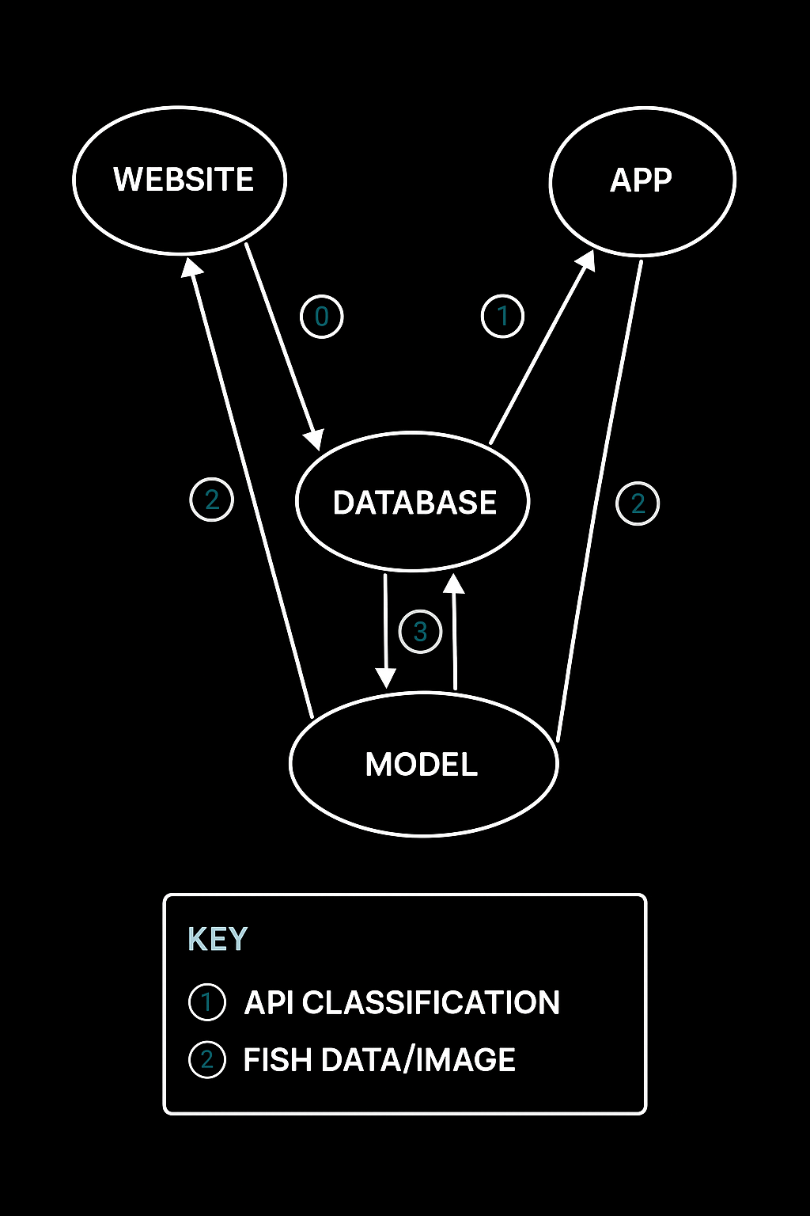
Overall System Structure
The system is structured around four main components: the Website, the Mobile App, the Database, and the Model. Both the website and the app communicate with the database through an API for classification tasks, sending requests and receiving results. The database serves as the central hub, storing and managing fish data and images, while also facilitating interactions with the model.
Data Flow Pipeline
Fish species data
Predicted
PyTorch model processes image

Slide 9
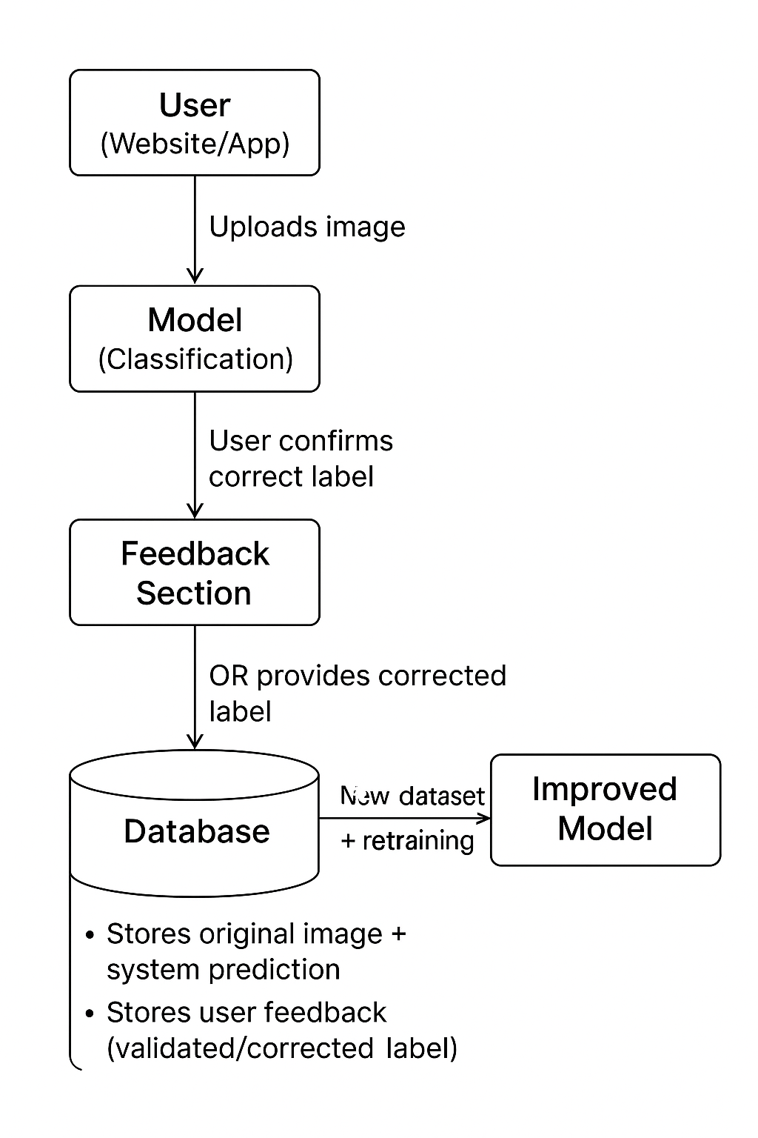
Active Learning System
In the Active Learning System, the feedback section of the website plays a crucial role in improving the model over time. When a user uploads a fish image and the system provides a classification, the user is given the option to confirm if the label is correct or to submit the correct label if it is wrong. This feedback is then stored in the database as a validated entry.

Slide 10
The Mathematical Journey:
Phase 1: 60% - FAILED
Phase 3: 98% - SUCCESS
Basic CNN Architecture
ResNet-50 Breakthrough
Gradient vanishing prevented deep learning:
∂L/∂W₁ = ∂L/∂W₃ × ∂W₃/∂W₂ × ∂W₂/∂W₁ → 0
Residual learning solved gradient flow:
H(x) = F(x) + x
1
2
3
Phase 2: 85% - IMPROVED
MobileNet v3 Efficiency
7.9x fewer parameters with depthwise separable convolutions:
O(DK² + DK) vs O(DK²M)
Efficient but lacked representational capacity for fine-grained quality assessment.

Slide 11

Winner : Residual Learning
The Core
ResNet's residual blocks fundamentally changed how gradients flow through deep networks. Instead of learning the desired mapping H(x) directly, the model learns from the residual
F(x) = H(x) - x.
Mathematical Advantage:
Identity mappings enable gradient flow: ∂H/∂x = ∂F/∂x + 1
50 layers deep without vanishing gradients
Transfer learning from ImageNet accelerated convergence

Slide 12



Quality Assessment
Eye Clarity (E)
Gill Color (G)
Skin Condition (S)
Weight: 0.3
Weight: 0.3
Weight: 0.4
Measures corneal transparency and pupil definition. Fresh fish have clear, bright eyes; degraded fish show cloudiness.
Analyzes red pigmentation and tissue integrity. Bright red indicates freshness; brown indicates oxidation.
Evaluates mucus layer, scale adherence, and texture. Accounts for species-specific variations in appearance.
The Quality Formula
where E, G, S ∈ [0, 100]. Skin condition receives the highest weight (0.4) due to its superior predictive power for overall freshness.
Market Impact Example
Sea Bass: Standard $24/lb → Sushi-Grade $76.20/lb
27% premium for top-grade classification
Storage: 0-2°C (24 hr) vs 4°C (72 hr)

Slide 13

Loss Function & Optimization
Adam Optimizer Configuration
Categorical Cross-Entropy
Learning rate α: 0.001
Momentum β₁: 0.9
RMSprop β₂: 0.999
Epsilon ε: 10⁻⁸
where C = 8 fish species,
yi = true one-hot label,
ŷi = softmax predicted probability
Adam combines momentum and adaptive learning rates: mt = β₁mt-1 + (1-β₁)gt
This loss function naturally handles multi-class classification and provides strong gradient signals for misclassified examples.
Regularization Strategy
L2 Weight Decay
Ltotal = LCE + λ × ΣW²ij
Dropout Regularization
Early Stopping
λ = 0.0001 penalizes large weights, promoting simpler decision boundaries and better generalization.
p = 0.5 (50% neuron dropout)
Patience = 10 epochs

Slide 14
Performance Metrics: The Numbers That Matter
98.2%
97.8%
98.2%
98.0%
Overall Accuracy
Precision (Macro)
Recall (Macro)
F1-Score (Macro)
(TP + TN) / Total
TP / (TP + FP)
TP / (TP + FN)
Harmonic mean
99.4%
0.8s
ROC-AUC
Inference Time
Area under curve
Per image
Mathematical Definitions
Accuracy: Proportion of correct predictions across all classes
Recall: Among actual positives, how many did we correctly identify
Precision: Among predicted positives, how many are actually positive
F1-Score: Harmonic mean balancing precision and recall

Slide 15
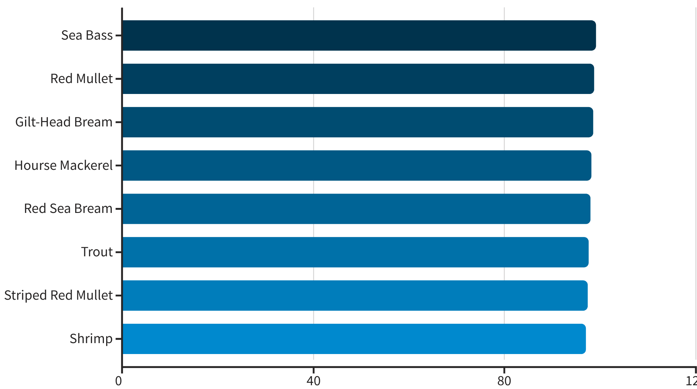
Per-Species Performance Analysis
Our model achieves consistently high accuracy across all 8 fish species, demonstrating robust feature learning beyond simple pattern memorization.
The minimal variance (99.1% to 97.1%) across species indicates our model learned generalizable quality features rather than species-specific memorization patterns. Even the lowest-performing species (shrimp) achieves 97.1% accuracy.

Slide 16
Thank You!

Slide 17


